Slide 1
Key

Slide 2
What is a KEY?
A KEY is a value used to identify a record in a table uniquely. A KEY could be a single column or combination of multiple columns
Note: Columns in a table that are NOT used to identify a record uniquely are called non-key columns.

Slide 3
Various Keys in Database Management System
Following are the various keys:
  Super Key
  Primary Key
  Candidate Key
  Alternate Key
  Foreign Key
  Composite Key

Slide 4
Primary Key
A primary is a single column value used to identify a database record uniquely.
It has following attributes
  A primary key cannot be NULL
  A primary key value must be unique
  The primary key values should rarely be changed
  The primary key must be given a value when a new record is inserted.

Slide 5
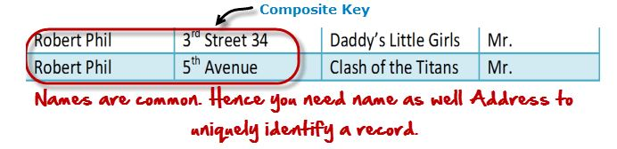
What is Composite Key?
A composite key is a primary key composed of multiple columns used to identify a record uniquely
In our database, we have two people with the same name Robert Phil, but they live in different places.

Slide 6
Foreign Key
Foreign Key references the primary key of another Table! It helps connect your Tables A foreign key can have a different name from its primary key
It ensures rows in one table have corresponding rows in another
Unlike the Primary key, they do not have to be unique. Most often they aren't
Foreign keys can be null even though primary keys can not

Slide 7
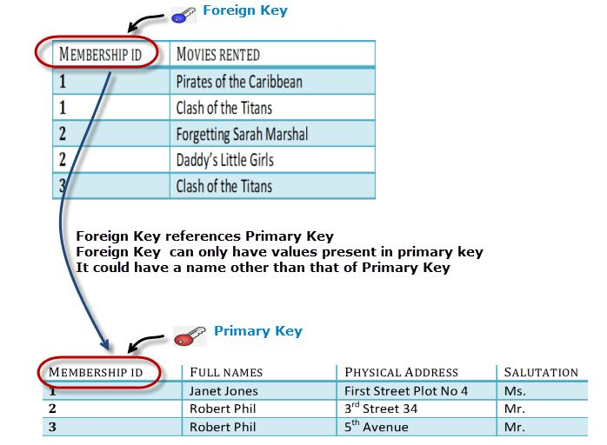

Slide 8
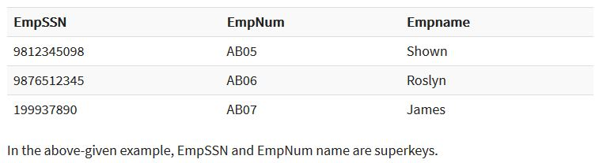
Super key?
A superkey is a group of single or multiple keys which identifies rows in a table. A Super key may have additional attributes that are not needed for unique identification.

Slide 9
What is a Candidate Key?
A super key with no repeated attribute is called candidate key.
The Primary key should be selected from the candidate keys. Every table must have at least a single candidate key.
Properties of Candidate key:
It must contain unique values
Candidate key may have multiple attributes
Must not contain null values
It should contain minimum fields to ensure uniqueness
Uniquely identify each record in a table

Slide 10
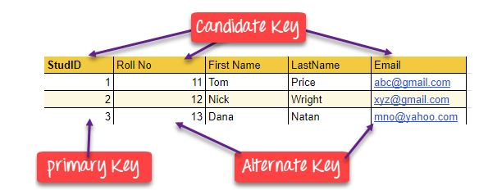

Slide 11
